Slide 1
NUMBER SYSTEM CONVERTER
USING PYTHON

Slide 2
INTRODUCTION
It contains a base conversion system and calculator
User can enter any number and convert them to any number systems(decimal to binary,binary to octal,etc)
This is a simple GUI-base project which is very easy to understand and use.
Also, this project makes a convenient way for the user to gain an idea of how to perform number conversion.

Slide 3
NUMBER SYSTEMS
The general representation of number systems are:
Decimal Number – Base 10 – N₁₀
Binary Number – Base 2 – N₂
Octal Number – Base 8 – N₈
Hexadecimal Number – Base 16 – N₁₆

Slide 4
eg.Decimal to Binary conversion
Decimal Number: 29₁₀
Calculating Binary Equivalent −
Binary number:11101
Step | Operation | Result | Remainder
Step 1 | 29 / 2 | 14 | 1
Step 2 | 14 / 2 | 7 | 0
Step 3 | 7 / 2 | 3 | 1
Step 4 | 3 / 2 | 1 | 1
Step 5 | 1 / 2 | 0 | 1

Slide 5
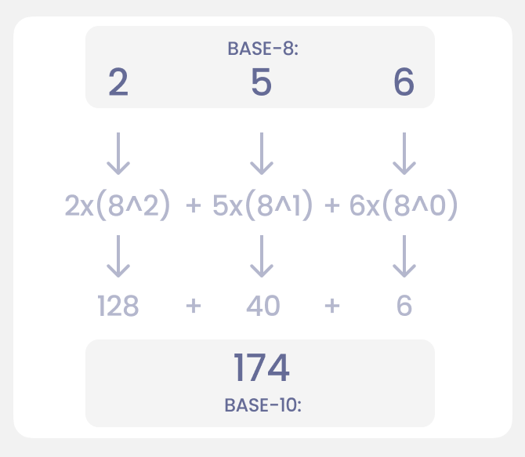
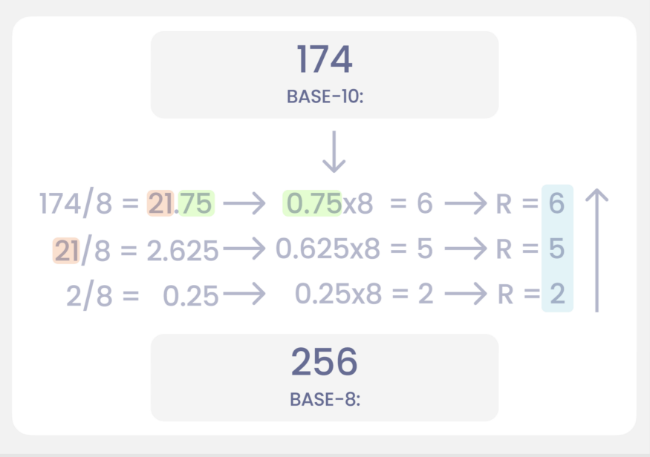

Slide 6
Applications of Number System
Hexadecimals are used in following:
- to define colours on web page
- to represent Media Access Control(MAC) addresses
- to display error messages
Decimals are used in:
- while dealing with money,weight,length,etc
Binary are used in:
- computer technology
Octals are used in:
- IT,Electronics and Computer Industry

Slide 7
The code output sample format
Welcome to the Number Base converter! The system will ask you for: - The Number to convert:(eg.29) - What base you want to convert FROM:(eg.10) - What base you want to convert TO:(eg.2)
** REMEMBER: All numbers must be integers!(unless HEX) **

Slide 8
The Code Logic
We pass three arguments to the function convert_number_system():
input_number is the number we want to convert.
input_base is the base we wish to convert from.
output_base is the base we wish to convert to.

Slide 9
Functions used
def menu() - The function returns the whole menu string so we can use it anywhere we want.
Validators:
def validate_bin(check_number) -This function just checks if the number is a valid binary number.
def validator(input_number,input_base,output_base):This function makes use of the other validators and validates all the input so we know if there is a point in proceeding with the conversion.
remainder_list - holds the numbers we want to return.

Slide 10
Presentation By:
Prachi Taware PRN:19UET049
Akshada Waghmode PRN:19UET053
Yogita Vanmore PRN:19UET051

